Slide 1
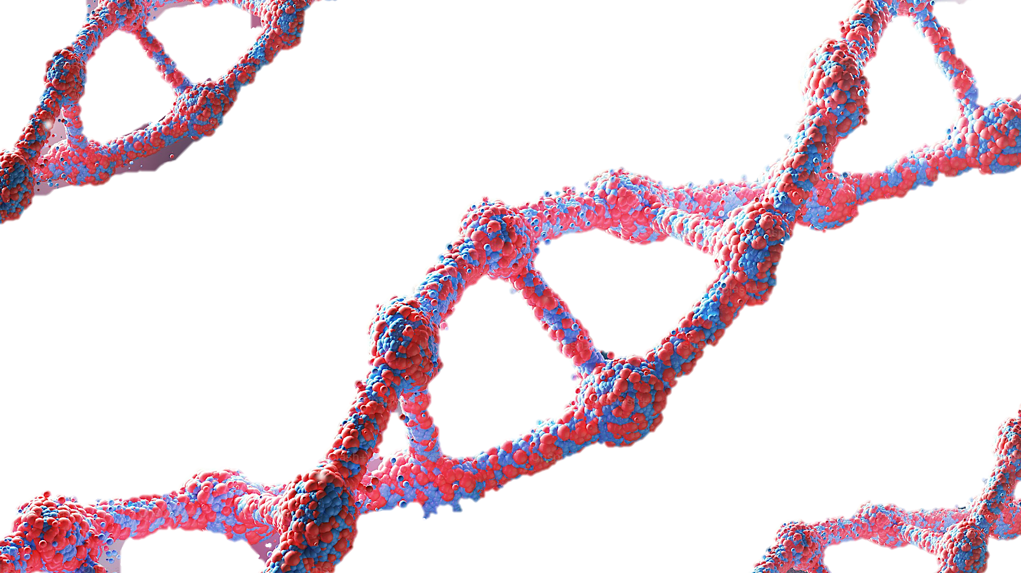
GC Project
10.28.24

Slide 2
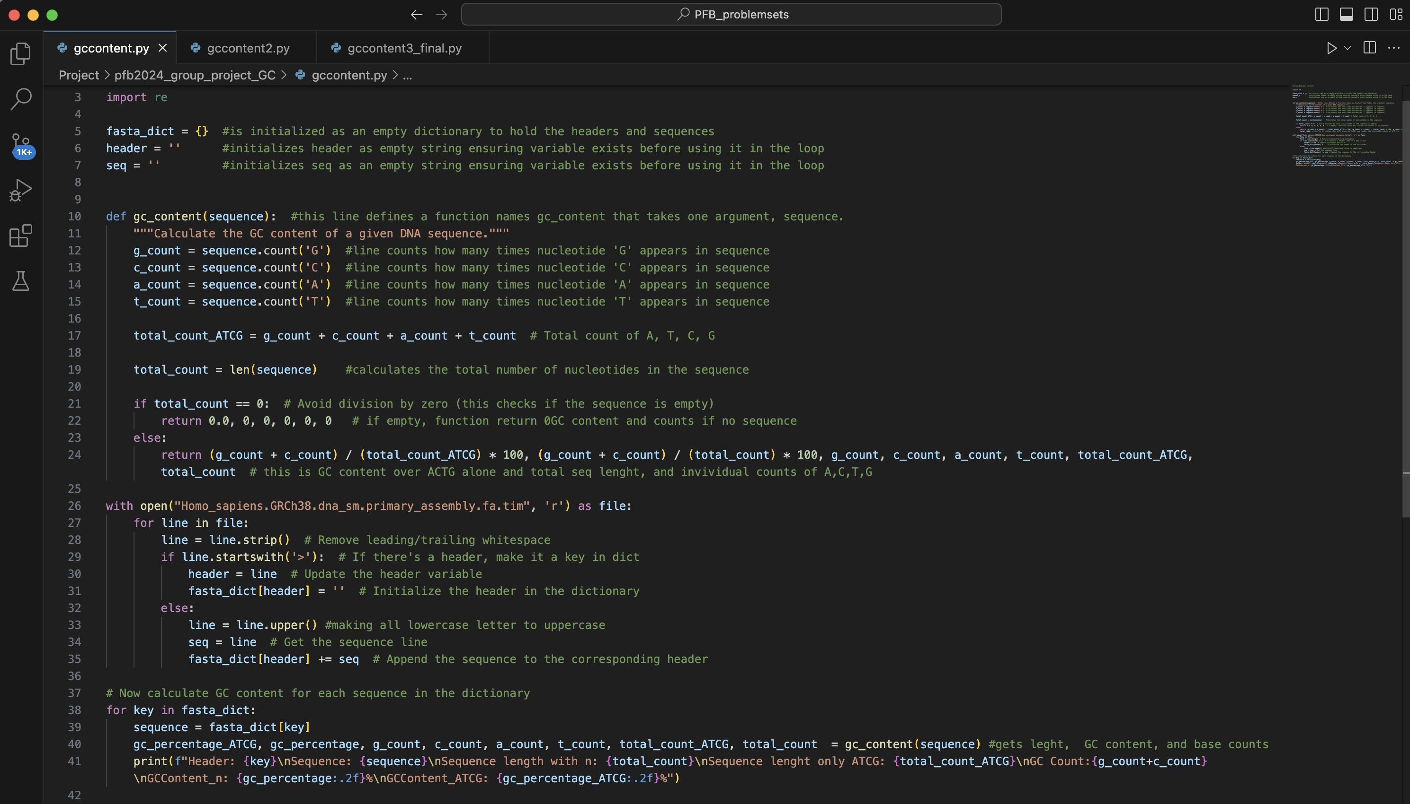
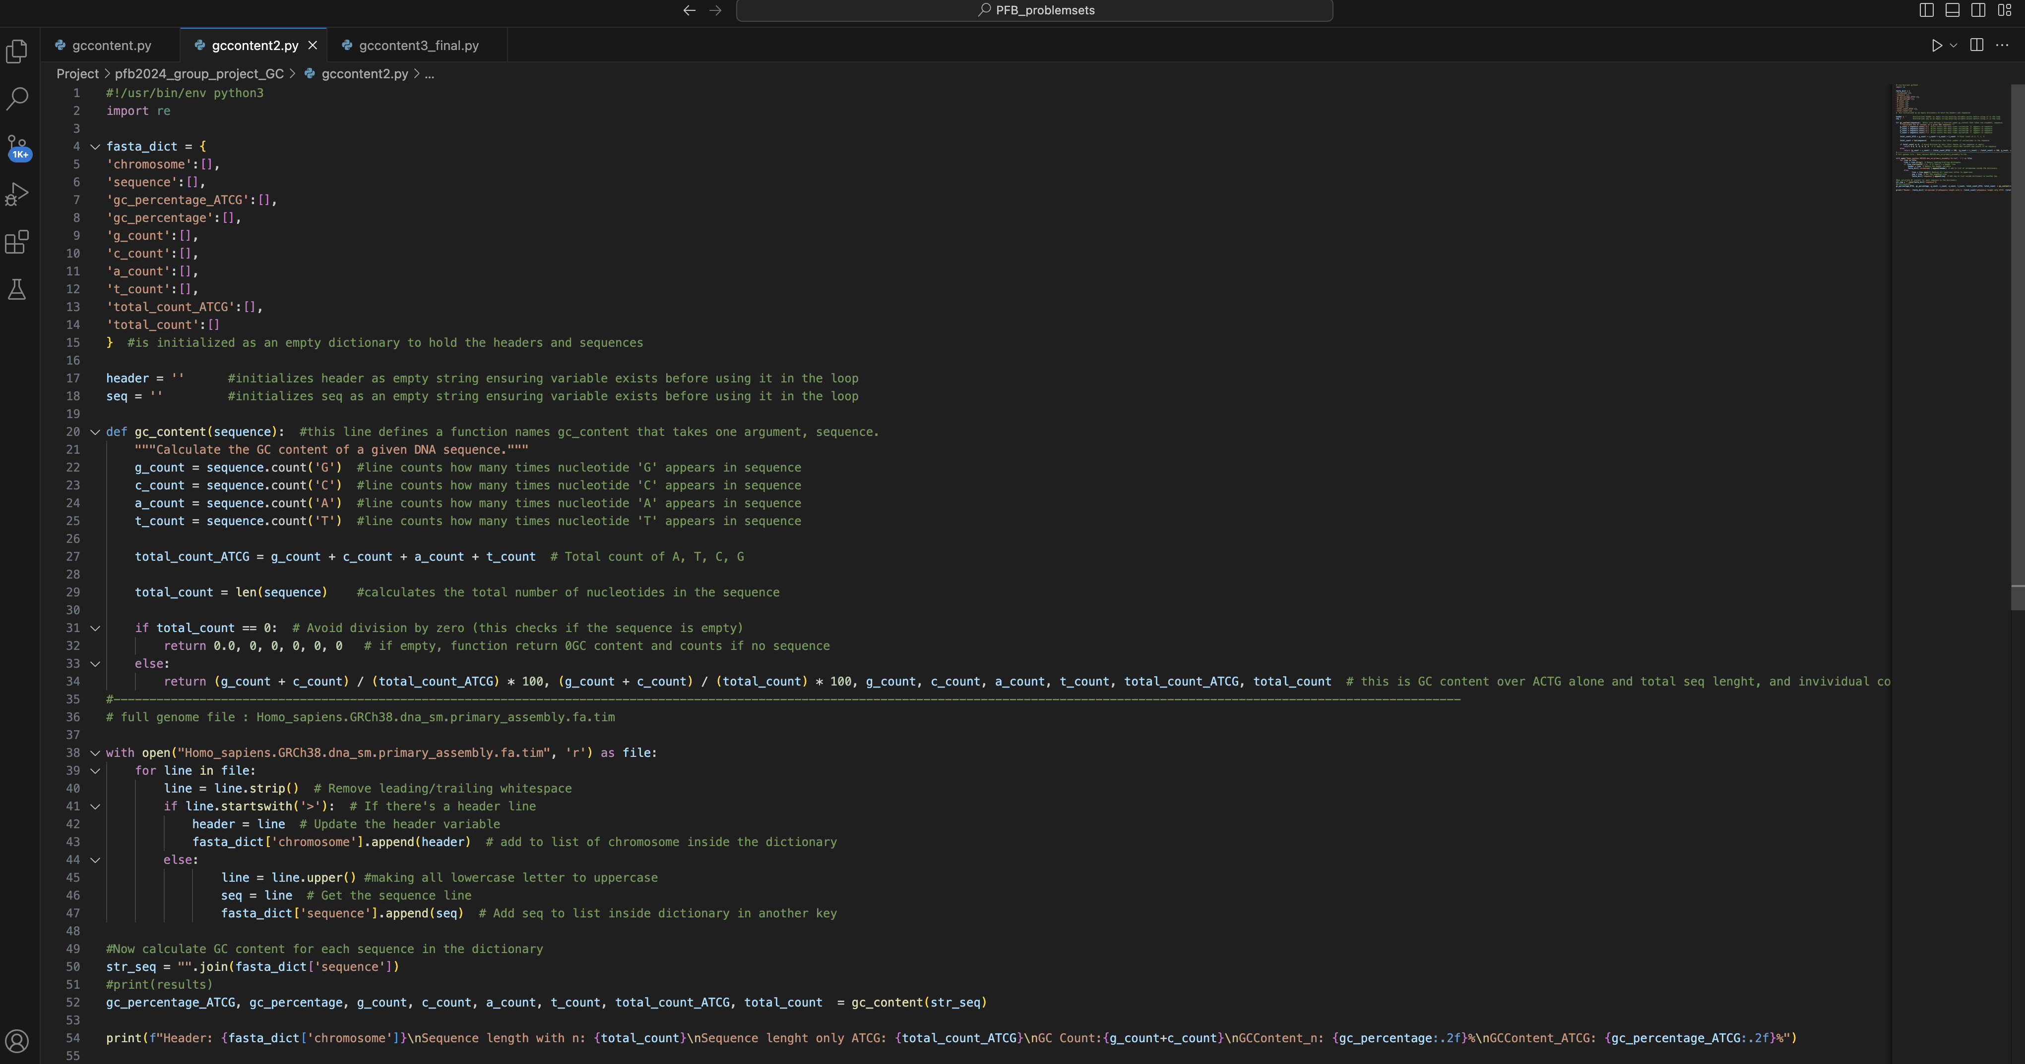
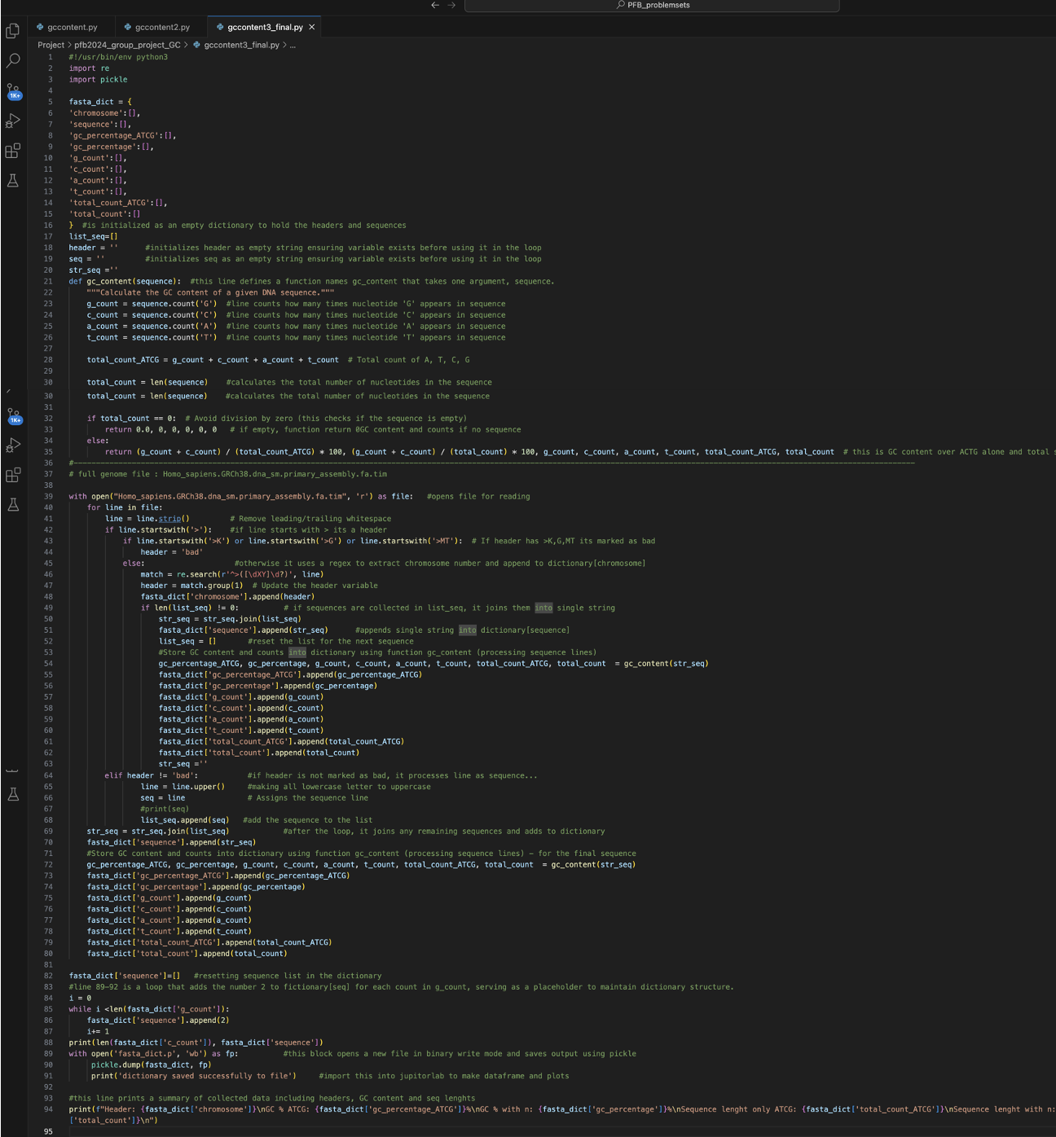
Evolution of the GC content Script
Script 1:
Script 2:
Script 3:
Notes:
The main goals of the present project were to:
Write a script that takes a whole genome and/or the coding part of a genome as input(s) and outputs either DNA length, GC count, and GC content (whole genome) or DNA length, GC count, GC content, amino acid counts, and amino acid contents (coding genome). The outputs were formatted as a double dictionary, with the chromosome number as the key for the outer dictionary and the name of the operation (e.g., DNA length, GC count) as the key for the inner dictionary. The actual numbers were the elements of the inner dictionary. We ensured that the script could be run for different species with similar genomes and executed it for the human, blue whale, and mouse genomes for further analyses.
Present the numbers in a graphical way using Pandas, Matplotlib, and Jupyter Notebooks. The inputs were the dictionaries created in step 1. The outputs included: a) a bar graph showing GC content averaged across the whole genome for the whole and coding human genome, b) a bar graph showing GC content per chromosome for the whole and coding human genome, c) scatter plots showing the association between GC content (whole and coding human genome) and the content of each amino acid (coding human genome), and d) a bar graph comparing the GC content averaged across the whole genome for the whole and coding genomes between human, blue whale, and mouse.

Slide 3
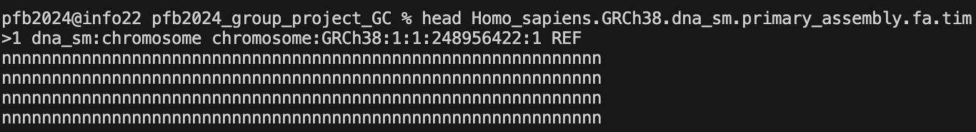
Script 1
Day 1:
Input:
Script:
Problem: ran from 6pm Saturday to 9 am Sunday and still going….
Thought about putting variables within a dictionary to reduce run time and be able to create figures of data.

Slide 4
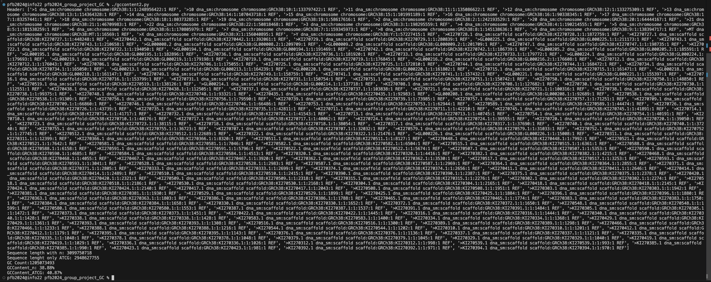
Script 2
Day 2:
Input:
Script:
Yay! Script ran with no errors!
Problem: output is wrong/weird
Needed to adjust several things:
removal of of unwanted DNA in the facta_dict = { ‘chromosome’:[]
Appending the correct number of values in the other dictionaries within facta_dict. As you can see, currently only the last sequence has its data saved.
Output:
Unwanted DNA
Last sequence saved only

Slide 5
Script 2
Problem: has made a dictionary of all chromosomes including scaffolds and unwanted DNA. Another issue is that it only saved the values for the last sequence in the other dictionaries (need to find out why).

Slide 6
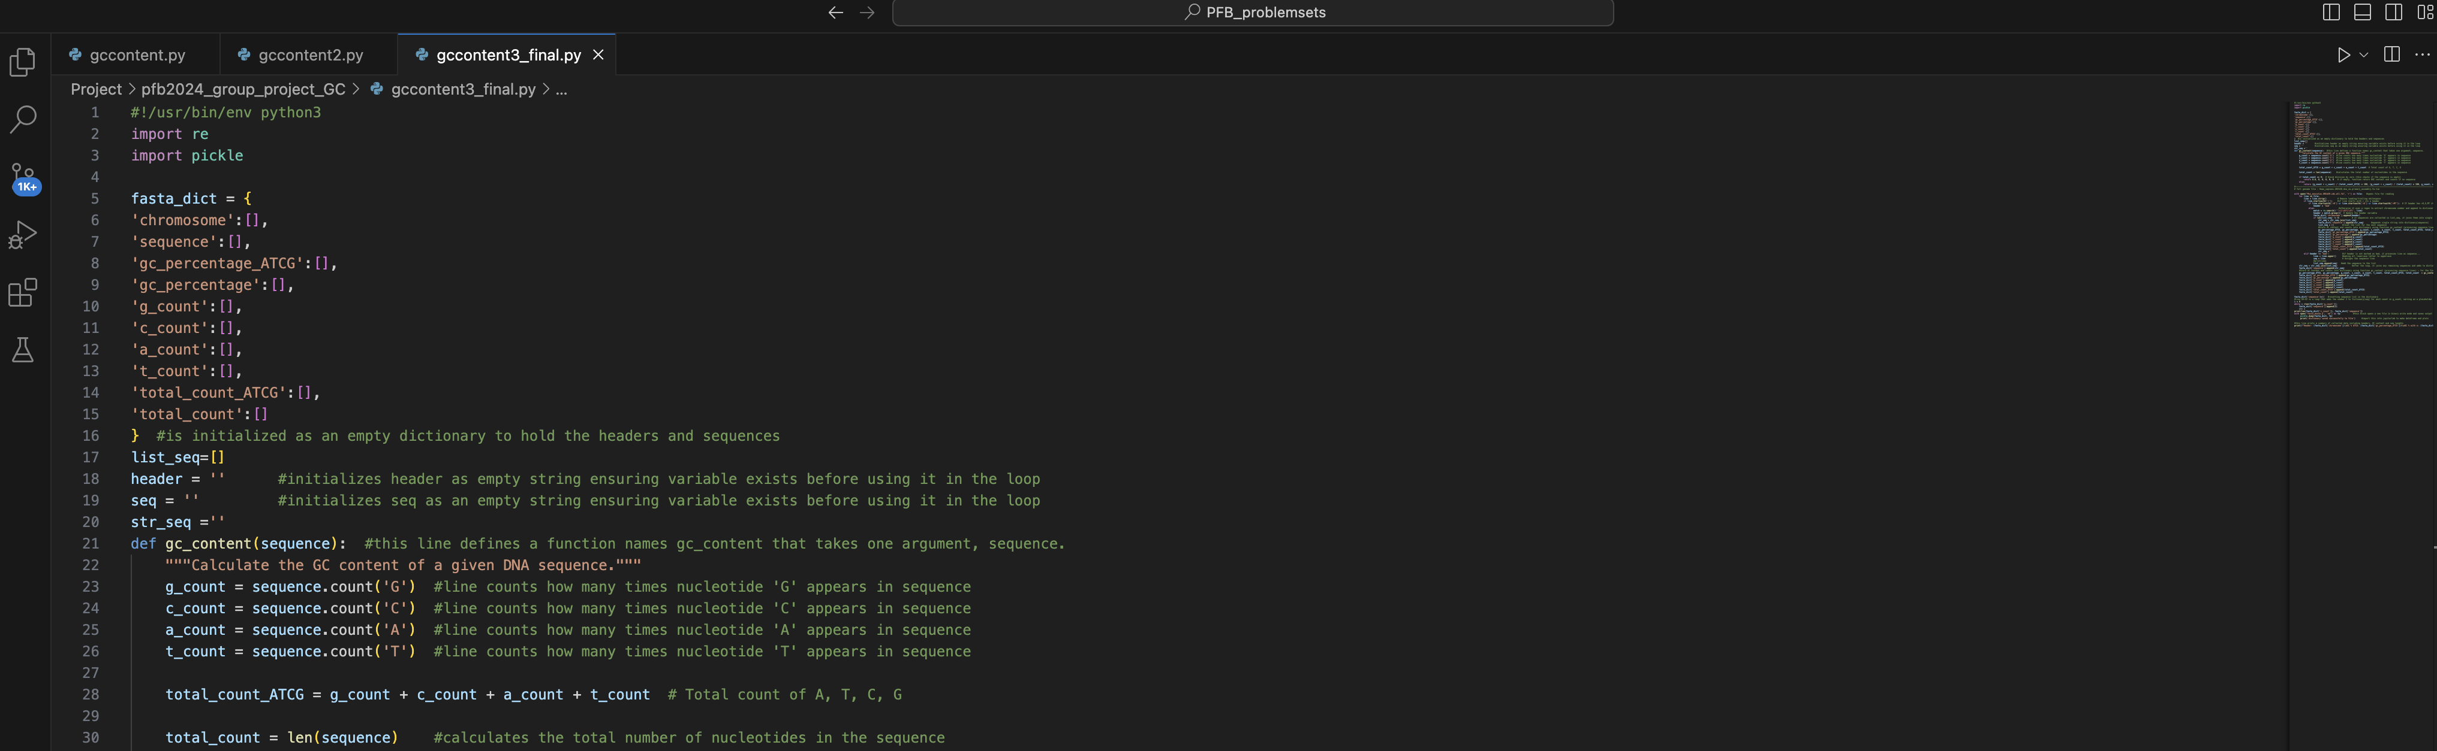
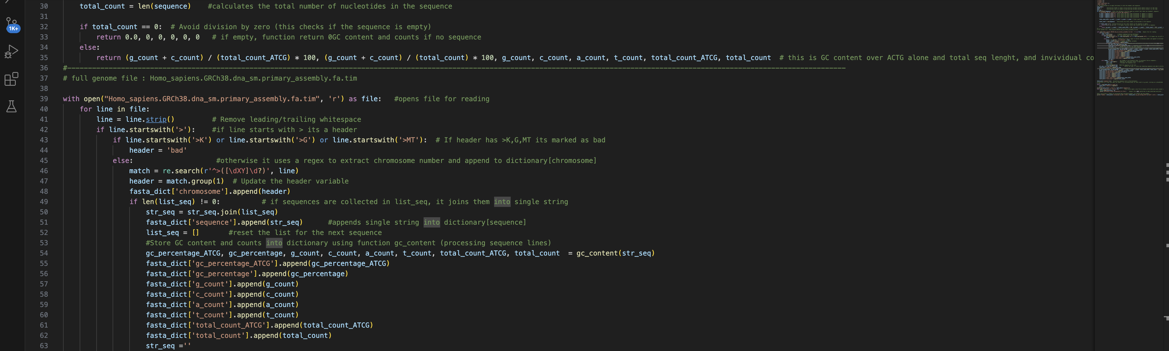

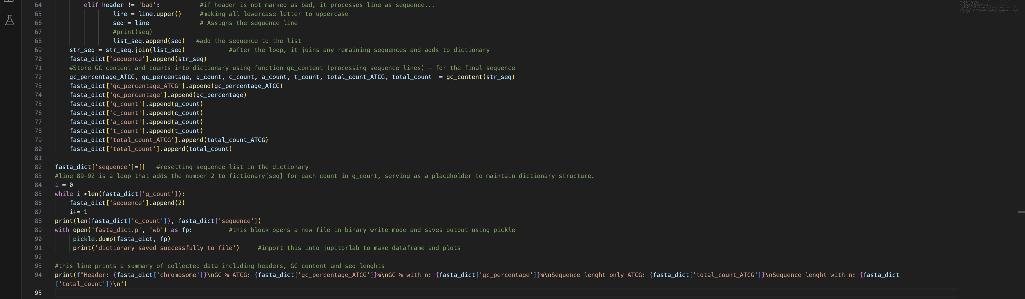
Script 3
Day 2:
Script:
Yay! Script ran with no errors!
Yay! Script ran whole human genome in 1 min
Yay! Contains only chromosomes we want!
Created 2 outputs:
to screen
save to pickled to file.

Slide 7
Script 2 versus 3 – what did we change?
Script 3:
Script 2:
Needed this similar code outside of the loop to ensure that is there are any remaining sequence lines accumulated after loop completes, to join and add them into the {}, to avoid data loss.
Adds headers to dictionary w/o filtering
Appends each line to sequence list
Calculates GC content after processing all sequences may have incorrect values.
output only prints summary at end
Filters headers to exclude ‘bad’ ones (>K, >G, >MT)
Uses temp list to accumulate sequences for each header and joins them when new header encountered.
Calculates GC content for each sequence immediately after collecting them → more accurate.
Output prints and saves {} as file using pickle.

Slide 8

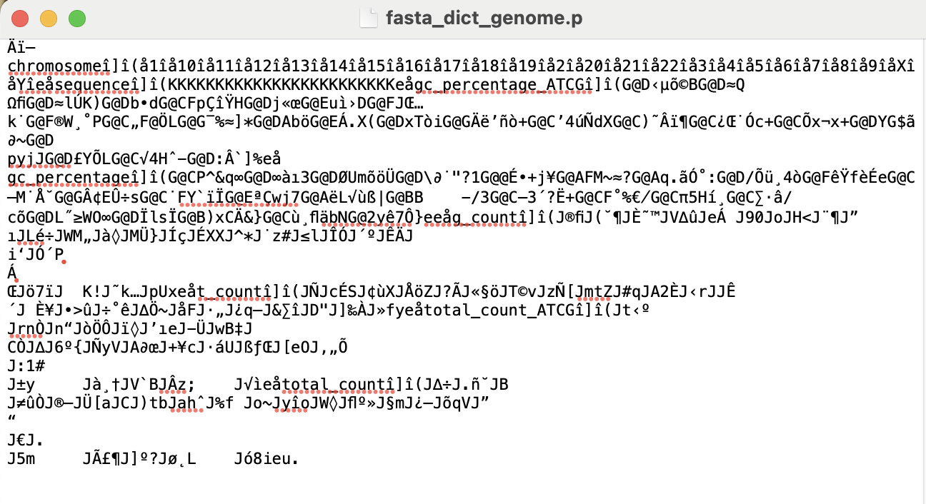
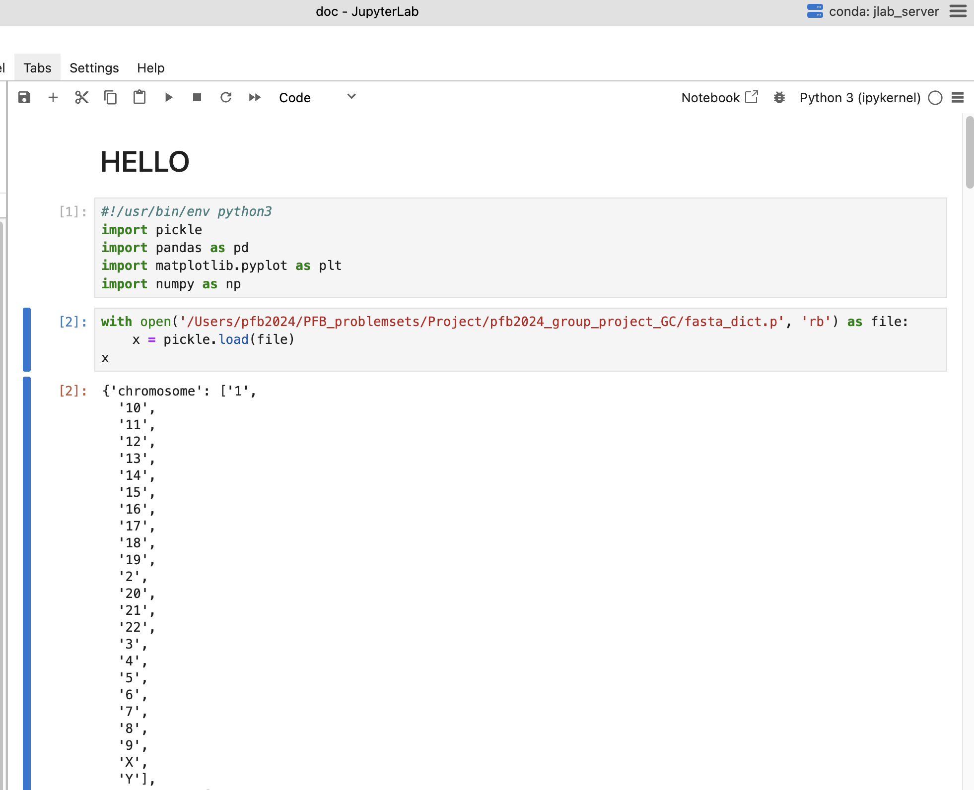
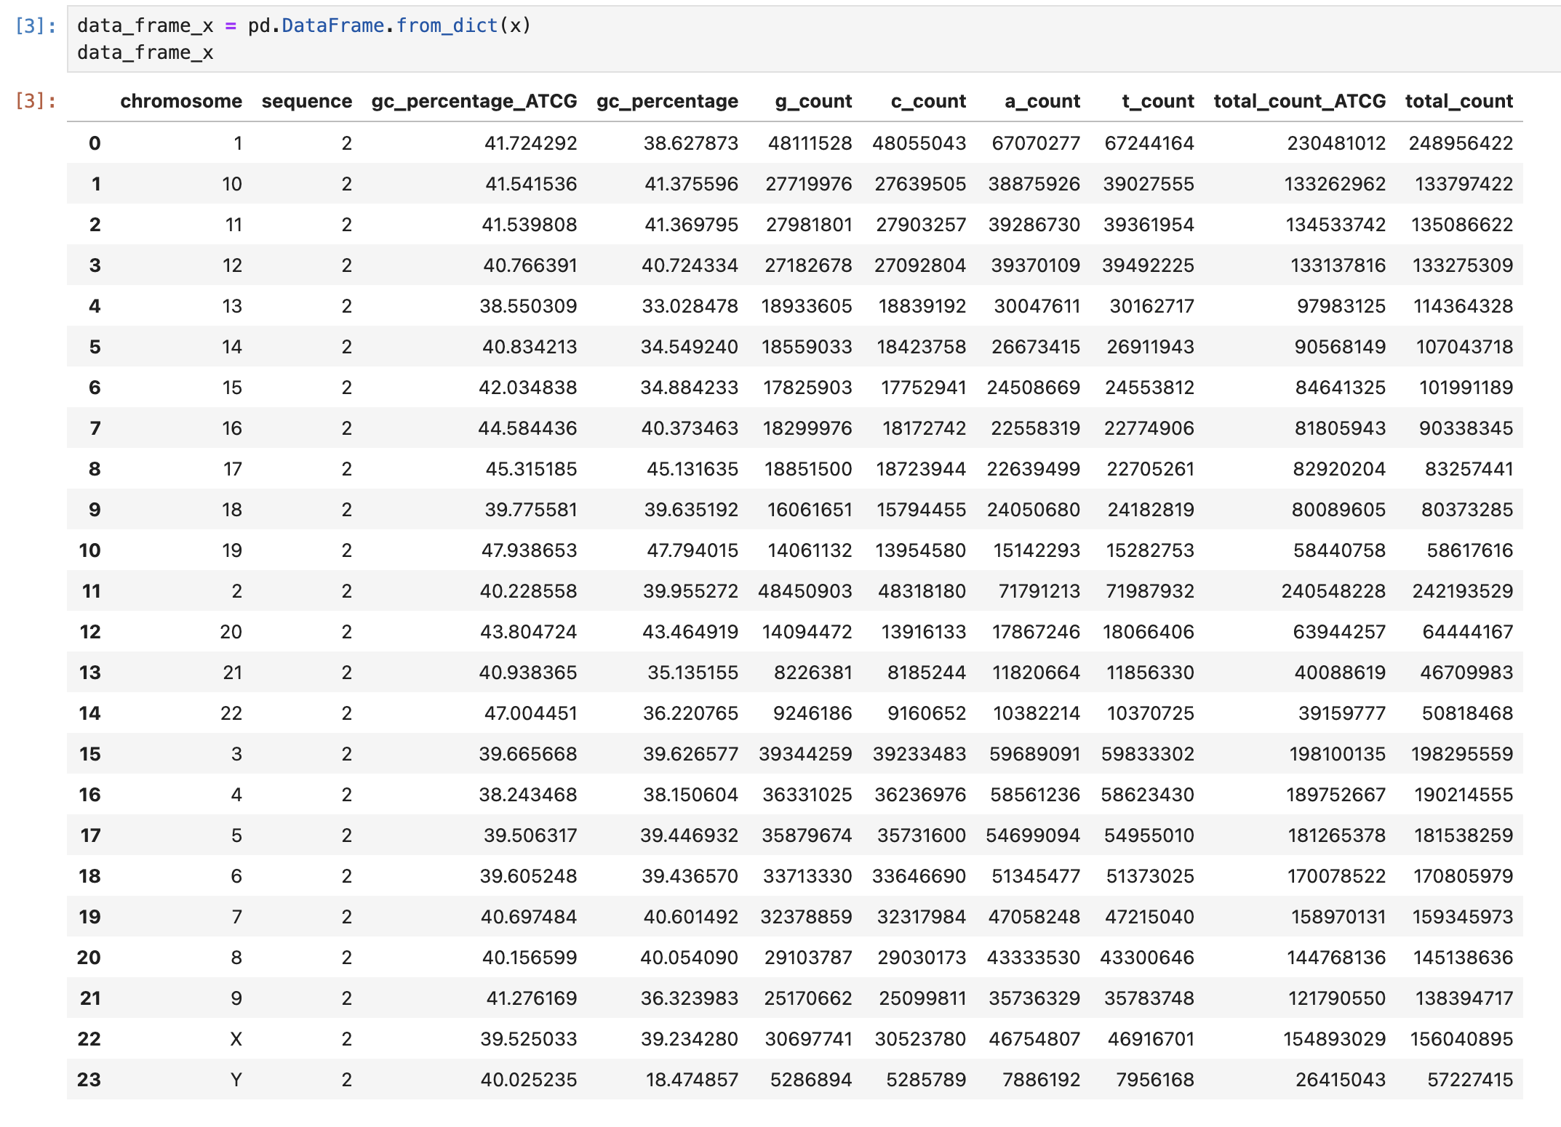
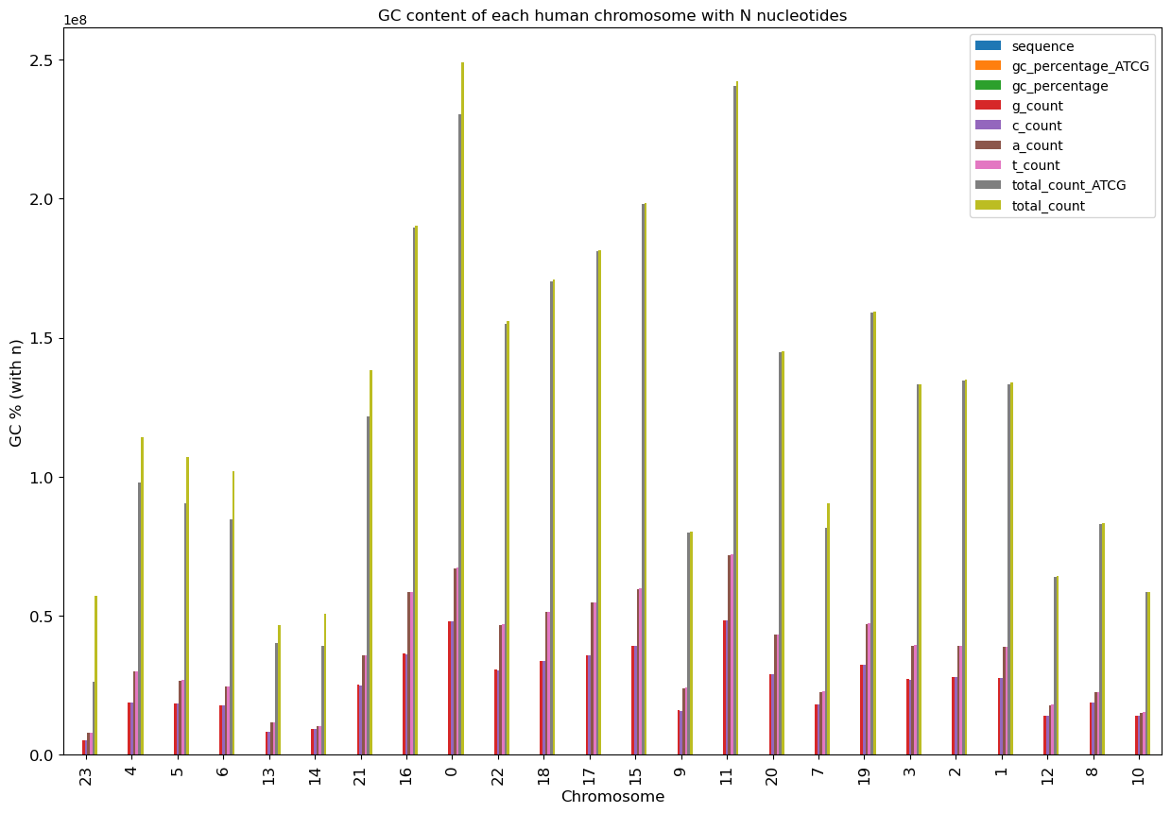
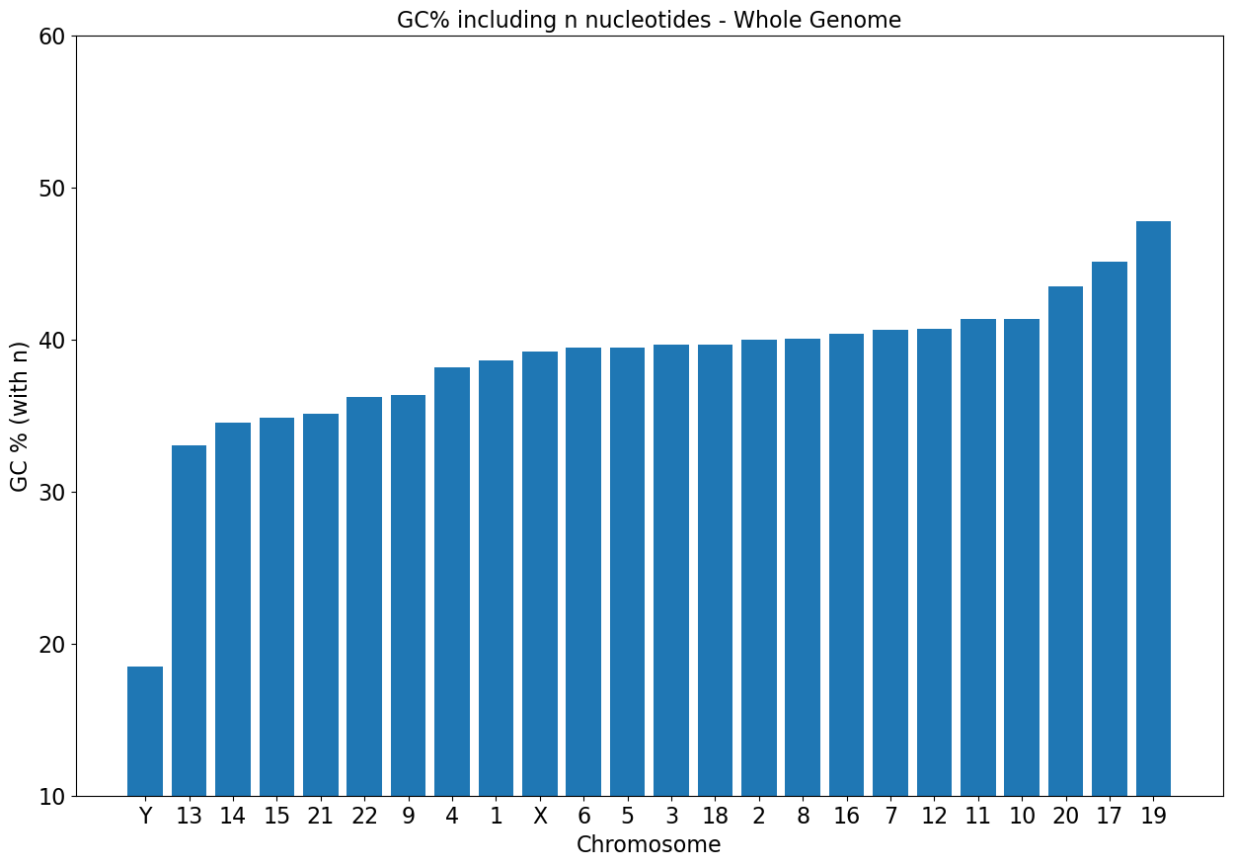
Script 3 visualization using JupyterLab
Output on screen:
Open pickle with JupyterLab
Use Pandas to visualize Data Frame
Data Frame to plot with Matplotlib
Output saved to file:

Slide 9
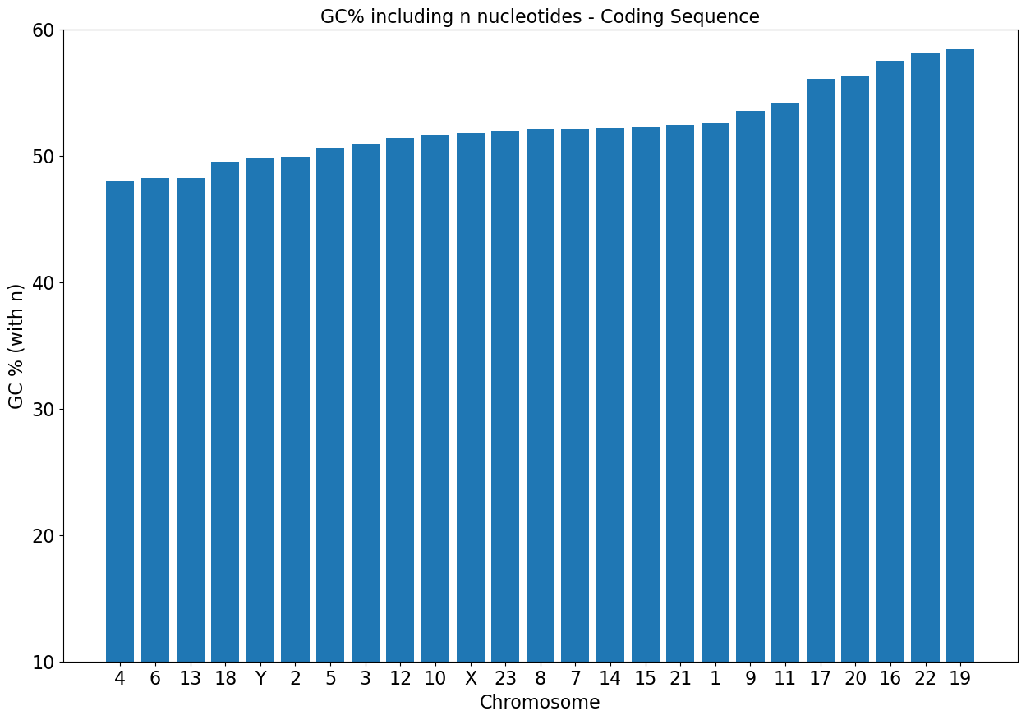
Human: GC percentage with all nucleotides (+n)
Whole Genome Sequence
Coding Sequence

Slide 10
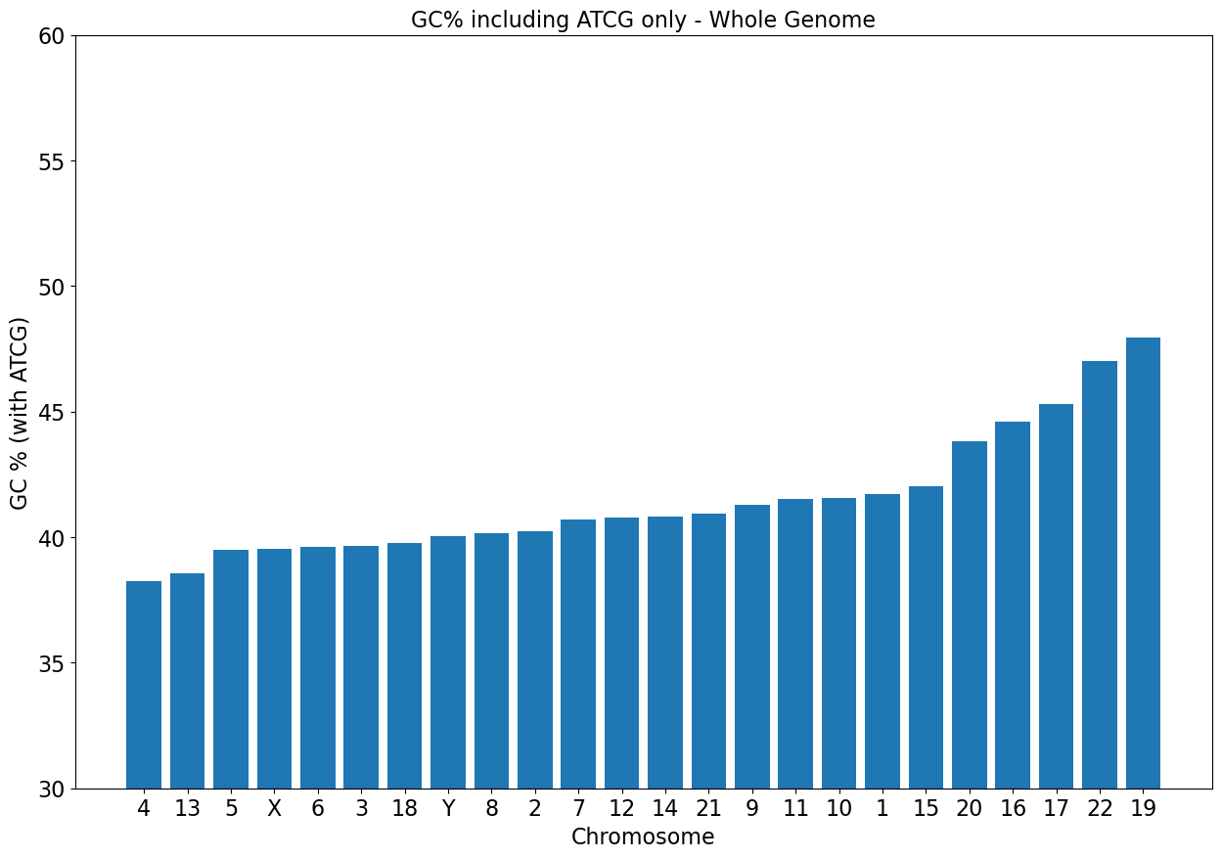
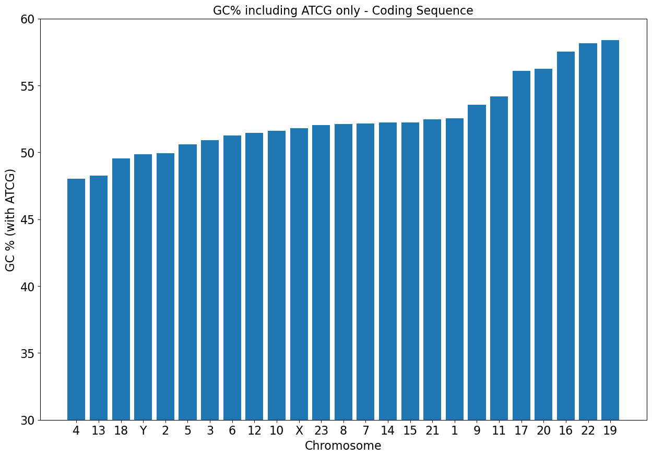
Human: GC percentage with ATCG nucleotides
Whole Genome Sequence
Coding Sequence

Slide 11
Learning and Problem Solving
Key Challenges
Data Handling issue with large datasets and errors. Solution was to optimize data by making dictionary within dictionaries.
Scripting Errors where scripts had bugs that led to incorrect GC content calculations. Solution was to debug and using several test samples to identify and fix script accordingly.
Learning Points
Value of keeping previous scripts and note taking to track changes and understand code evolution.
Patience and persistence when code fails endlessly
Having collaborators and TA to help understand problems and coming up with solutions together.

Slide 12
The Evolution of the Code
My final script builds upon the first two with key differences and enhancements:
Data Structure: the final script uses a dictionary to organize data with specific lists for chromosomes, sequences, GC percentages, and counts while the first used a single dictionary to hold headers and sequences and just calculated it one by one and printed it to screen.
Handling Headers: The second script excludes “bad” headers (unwanted DNA).
Sequence Storage: second script uses a temporary list to collect sequences until a new header is encountered, this while the first script which appended sequences directly to the dictionary.
Final joining of sequences: the final script joins sequences after the loop ends ensuring all part of the sequence are captured before calculations are done.
Placeholder for sequences: we added a placeholder value (2) to the sequence key for each count in ‘g_count’, to maintain consistent dictionary structure for later use since we didn’t need to save the entire sequence of a chromosome (HUGE + not needed)
Output Storage: in addition to printing results on the screen, the second script also saves the dictionary structure to a file using the pickle module for easy loading and analysis later.
Notes:
I've accomplished so much more than I initially thought I could, especially considering how challenging coding has been for me. This journey has taught me not only technical skills but also resilience and problem-solving. I'm proud of the progress I've made!

Slide 13
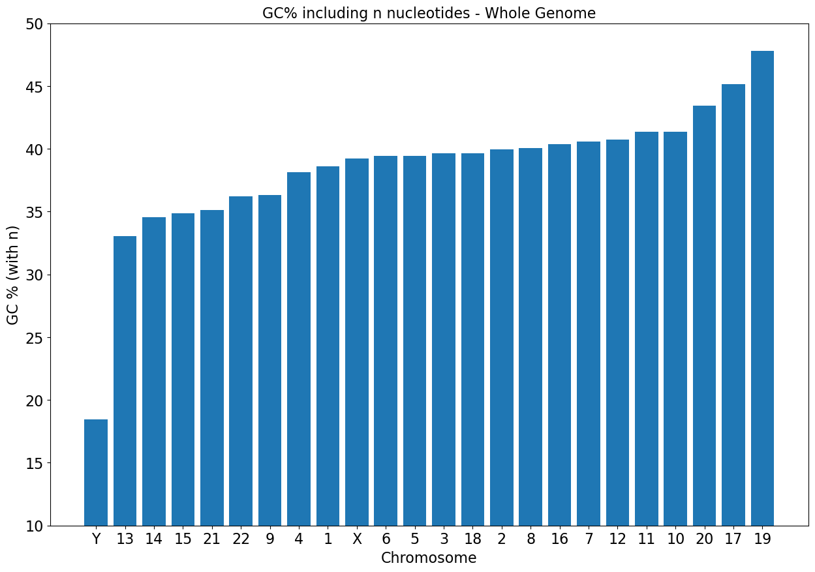
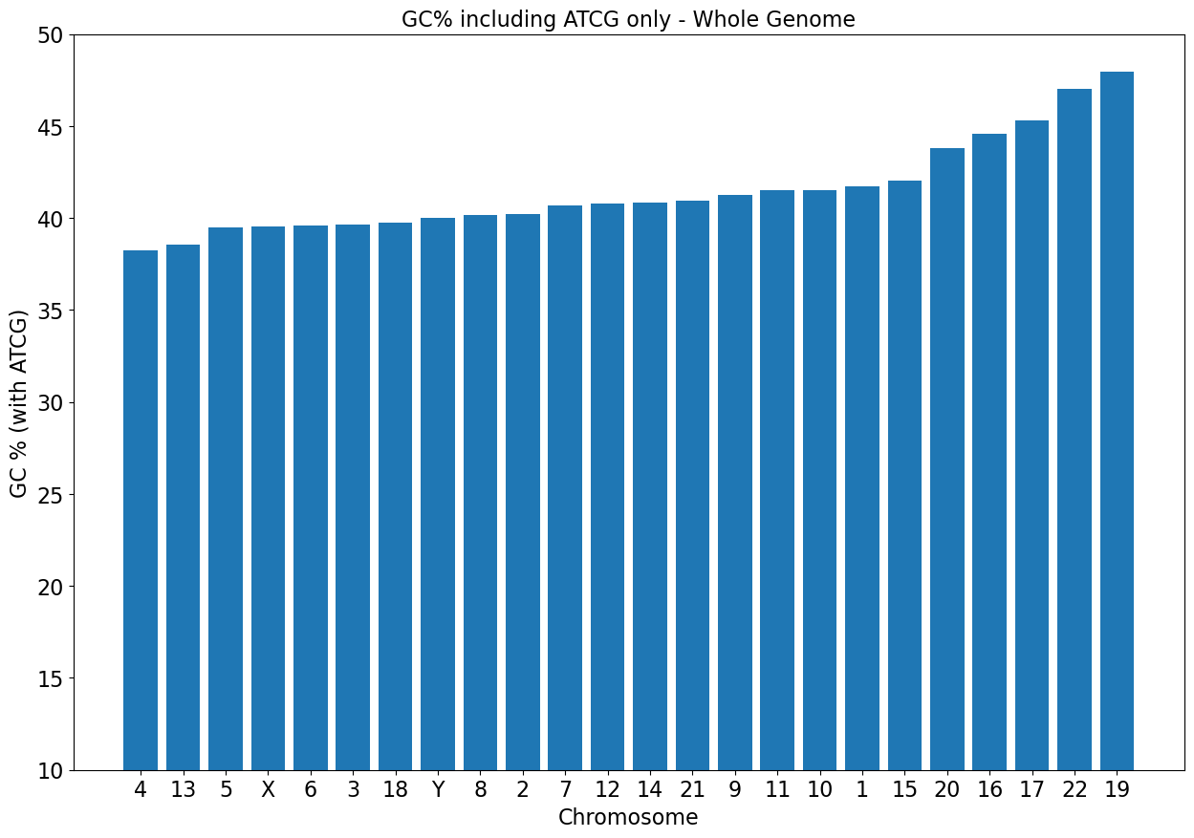

Whole Genome
Coding Sequence

